Slide 1

WEEK 04 arcgis field map lecture
Instructor: Yanan Wu
fALL 2025

Slide 2
4.1 introduction

Slide 3
Overview
Field Maps is an all-in-one app that is widely used for mapcentric data collection
functioning with or without network connectivity.
It also supports utility network editing and tracing, location sharing, Geofences, task assignments, workforce coordination, webhook automation, and more

Slide 4
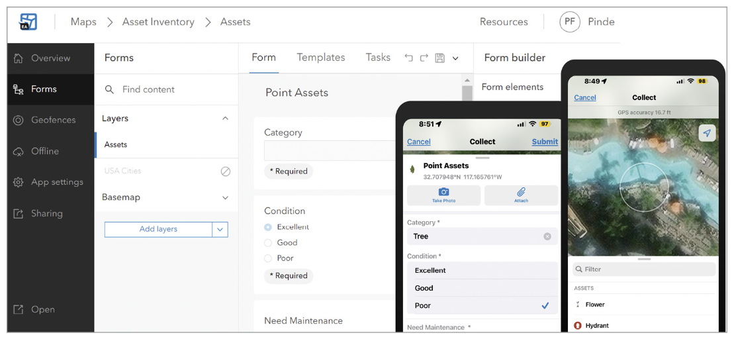
TWO COMPONENTS
Field Maps Designer: This component is for solution creators or map authors to use. It can design layers and maps, create smart forms, enable maps for offline use, set up Geofences, and configure various settings to optimize maps for field workflows.
Field Maps mobile app: This component is for mobile workers to use. Using this app, mobile workers can open the maps, forms, data, and tools necessary to complete their field tasks. Field Maps is designed to function online and offline, as well as in outdoor and indoor environments.

Slide 9
Overview
Overview
ArcGIS Collector
Capture assets and observations
Perform inspections
Workflow
Overview

Slide 10

Thank you!

